Slide 1

Exploratory Analysis of Diabetes and Pregnancy Data
Samantha Traversi
MDS 546

Slide 2
Snapshot of Diabetes and related Health Tests
Diabetes is a condition where the body either does not produce insulin, or is unable to manage the insulin levels in order to process glucose, a sugar that serves as the body’s main source of energy.
Plasma Glucose Concentration is tested in the blood after a period of fasting and then consuming a glucose-rich beverage. Within two hours of consuming the beverage, the blood glucose levels should return to close to normal in non-diabetic subjects. Diabetic subjects will maintain a high level of glucose in the plasma.
Serum Insulin Test is similar to a Plasma Glucose Concentration test, but instead of measuring the plasma glucose level, you measure the insulin level. Diabetic subjects will be outside the normal range (higher or lower, depending on the type of diabetes).
Diastolic Blood Pressure is a measurement of the pressure of the blood against the artery walls when the heart is at rest. Subjects with diabetes tend to have higher diastolic blood pressure as the blood tends to be sticky and more difficult to move through the blood vessels.

Slide 3
Background of Diabetes among women in the pima Indian community
The information used in this analysis was originally collected by the National Institute of Diabetes and Digestive and Kidney Diseases in a study of the Pima Indian community.
When comparing the number of pregnancies among diabetic and non diabetic women of this community, the diabetic women tend to have more pregnancies overall.
 | Diabetic Subjects | Non-Diabetic Subjects
Mean | 4.866 | 3.298
Sample Standard Deviation | 3.741 | 3.017
Number of Observations | 268 | 500

Slide 4
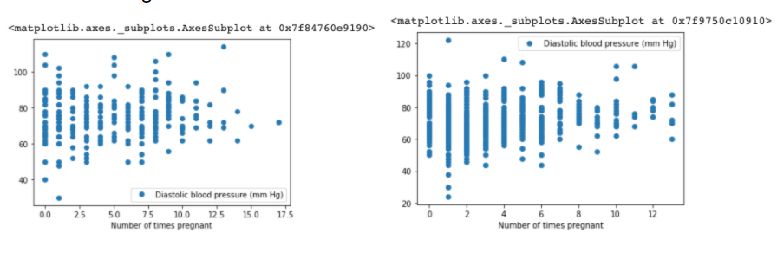
The relationship between the number of times a woman has been pregnant and her Diastolic Blood Pressure

Slide 5
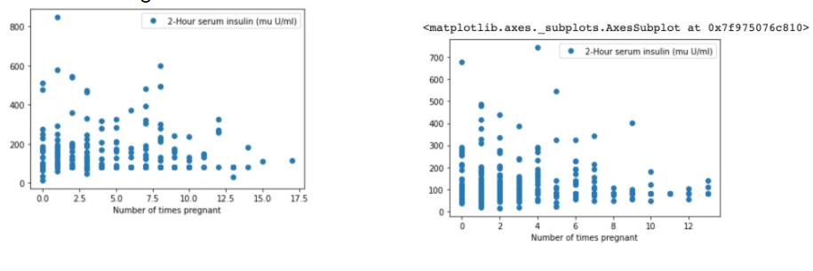
The relationship between the number of times a woman has been pregnant and her 2-Hour Serum Insulin Test

Slide 6
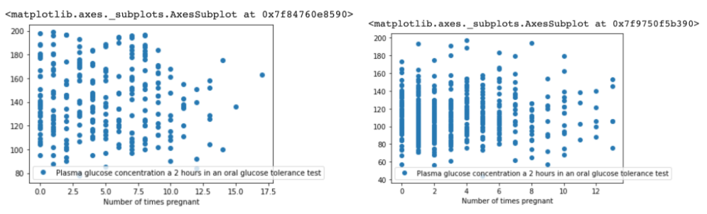
The relationship between the number of times a woman has been pregnant and her Plasma Glucose Test

Slide 7
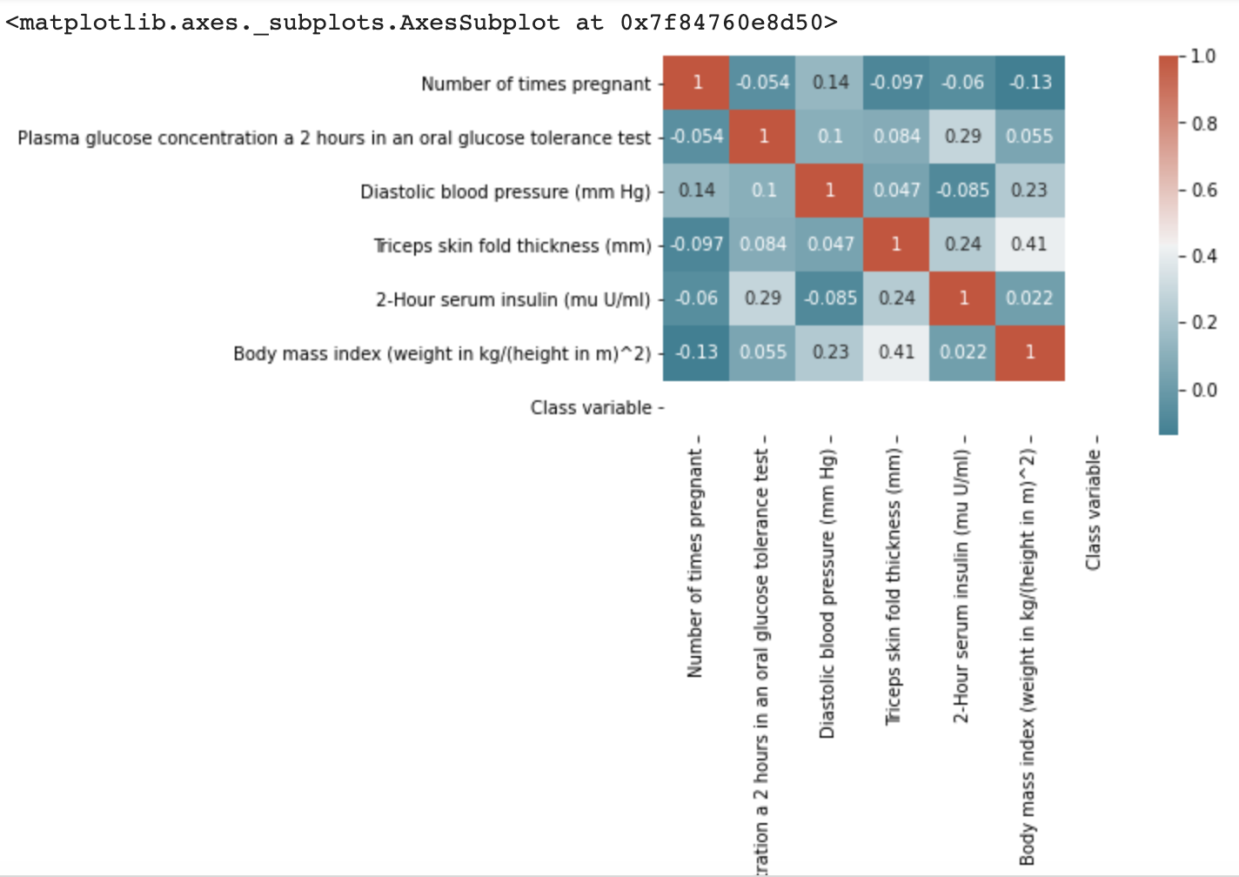
Heat Map Overview of Health Factors linked to diabetes and Number of Pregnancies in Diabetic Women

Slide 8
What Can We Draw from This Data?
There is a correlation between the number of times a woman has been pregnant and diabetes; however, we do not have enough information to determine whether this relationship is causal.
The relationship between number of times a woman has been pregnant, and the level of risk in her Plasma Glucose test, or Serum Insulin test, or her Diastolic Blood Pressure does not appear to have a linear correlation.

Slide 9
The Future of Diabetes Data
It is recommended to continue searching for correlations between pregnancy and the health factors that are involved when a subject has diabetes.
There is some data collected on the familial prevalence of diabetes for these subjects. It could be valuable to continue investigating the correlation between Diabetic Pedigree and specific health factors linked to diabetes.
There is also data collected on the age of the subjects. Since Type 2 Diabetes builds over time, more analysis should be performed to determine how age affects the other factors related to diabetes.

Slide 10
Works Cited
National Institute of Diabetes and Digestive and Kidney Diseases. (1999). Diabetes.csv. Retrieved from https://www.kaggle.com/uciml/pima-indians-diabetes-database
Center for Disease Control. (2021). Diabetes. Retrieved from https://www.cdc.gov/diabetes/index.html
American Diabetes Association. (2021). Diabetes Overview. Retrieved from https://www.diabetes.org/diabetes
Editor. (2019, January 5). Blood Sugar Level Ranges. Retrieved from https://www.diabetes.co.uk/diabetes_care/blood-sugar-level-ranges.html
The British Diabetic Association. (2021). Diabetes and Blood Pressure. Retrieved from https://www.diabetes.org.uk/guide-to-diabetes/managing-your-diabetes/blood-pressure
U.S. National Library of Medicine. (2021). Insulin in Blood. Retrieved from https://medlineplus.gov/lab-tests/insulin-in-blood/#:~:text=This%20test%20measures%20the%20amount,body's%20main%20source%20of%20energy.
Shanker, M., Hu, M., Hung, M. (1999, November 13). Estimating Probabilities of Diabetes Mellitus Using Neural Networks. Retrieved from http://www.personal.kent.edu/~mshanker/personal/Zip_files/sar_2000.pdf

